Slide 1
The Great Recession
Name
Course
Instructor
Date
Notes:
This presentation will focus on Great recession causes and responses.

Slide 2
Introduction
The great recession is a sharp deterioration in economic activity
The recession is regarded as the most momentous economic downturn since the great depression
Several causes led to the occurrence of the great depression
Fiscal and monetary policies were developed to curb the occurrence of another recession
The presentation will also recommend economic policies together with actions to avoid future recession
Notes:
When countries develop poor economic and financial policies as well as poor risk management strategies there will be an increased likelihood for the occurrence of an economic recession. Therefore, the great recession is a high-pitched deterioration in economic activity. Recession is regarded as the most substantial economic downturn since the occurrence of the great depression. This presentation will provide several causes that lead to the occurrence of the great depression, provide insights into whether the recession may happen again. Also, financial policies developed will be discussed that were developed to curb the occurrence of another recession and recommend economic policies to avoid future recession from happening.

Slide 3
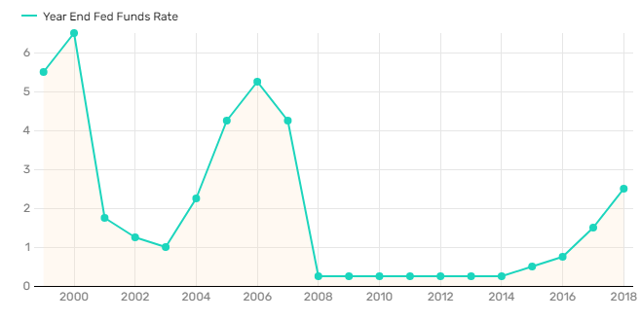
Causes of Great Recession 2008-2009
Failure of the government in regulating the financial industry (Ponnuru, 2018)
The development of subprime mortgages
Securitization
Increased rates of subprime borrowers (Ponnuru, 2018)
Notes:
Regulation of the financial industry is among the crucial role of the government in curbing recession. According to Ponnuru (2018), the fed monetary policy is to be blamed because they did not regulate the financial industry. Also, increasing property values and easy access to mortgages engrossed many individuals to benefit from home loans. However, this resulted in a housing market bubble. There was no security of loans because home loans were closely secured to hedge funds, derivatives and credit default swaps, thus the crush in the housing sector resulted in the United States monetary industry falling significantly. The fed was providing loans at an interest rate of 1.25%, however, due to increased demand for mortgage loans rates started to increase till 5.25% by 2006 (Ponnuru, 2018). This led to challenges to subprime borrowers as they were unable to pay.

Slide 4
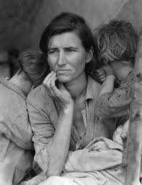
Has the Crisis Changed the Structure of the US Economy?
The structure of the U.S economy is changed
An initiative such as extending unemployment insurance is implemented (Tooze, 2018)
Financial policies are made more accommodative
More efforts are done to stabilize the financial market
Expand the job market
Notes:
The structure of the United States is structured by the recession because the government have learned that from the experiences. Therefore, to counter the challenges and the impacts experienced, labor markets is the one affected the most. According to Tooze (2018), argued that initiative such as increasing the unemployment insurance is executed to cater to the high unemployment rate and reducing the effects. Also, financial policies are considered to ensure they fit all individuals and more efforts placed on stabilizing the financial market. This includes reducing the number of institutions providing loans and monitoring them. Finally, is through expanding the job market to ensure many people are employed.

Slide 5
Could A Similar Recession Happen in the Future?
Similar recession can happen in future
Both fiscal actions and monetary policy are essential in preventing recession (Bivens, 2019)
The United States is poorly prepared for the next recession
There is increased inequality in the current economy
Policymakers are resistant to increase public spending due to increased public debt (Committee for Economic Development, 2018)
Notes:
Similar recession can happen in future because of the events and actions taken by the required systems. Bivens (2019), argues that although the federal reserve action is essential in preventing recession, it cannot accomplish the fight by itself. Also, another reason for a similar recession might happen is because the United States is poorly prepared as they have focused on the reason which resulted in the occurrence of the 2008 recession including low-interest rates and high public debt. However, they have not decreased inequality from the growing economy and also policymakers have not yet attained the importance of fiscal policy in enhancing public spending as it is useful in economic recovery (Committee for Economic Development, 2018).

Slide 6
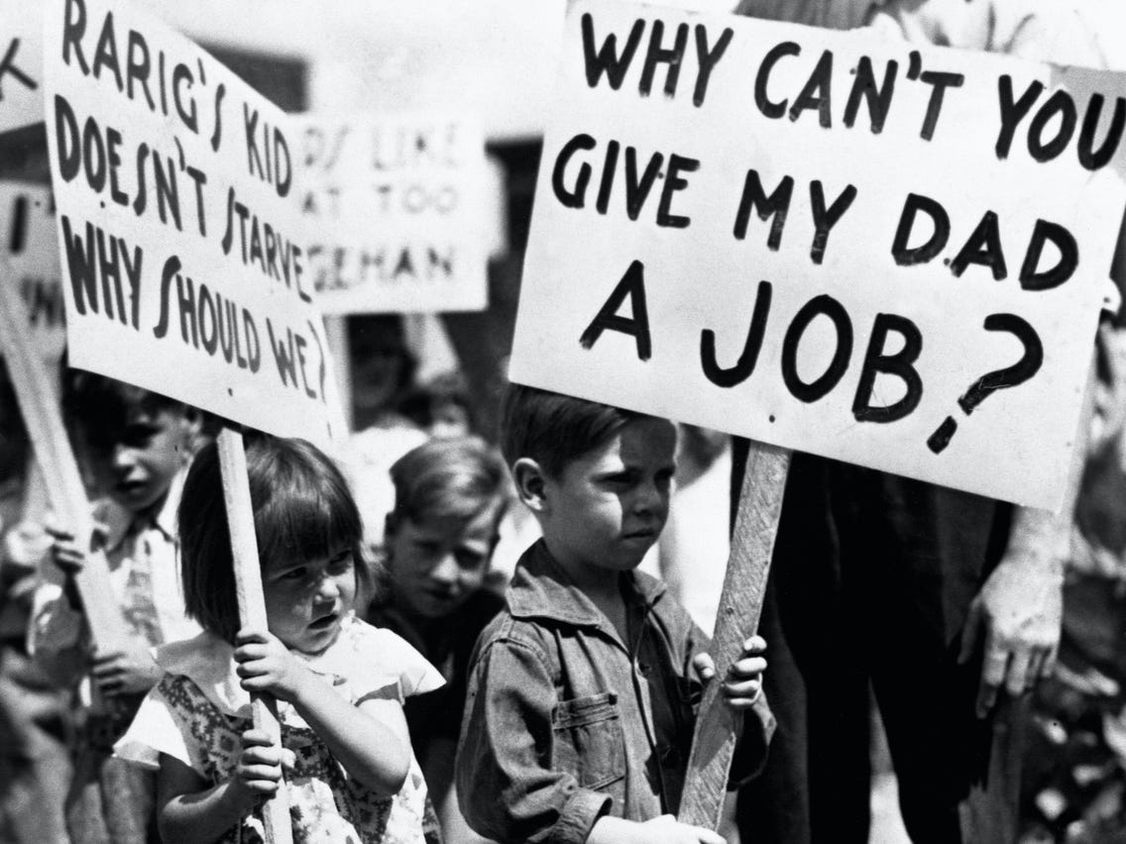
Economic Advice
Workforce management
Debt (Ponnuru, 2018)
Decision-Making
Digital Transformation
Notes:
Financial knowledge plays a critical role in making the business continue to operate during the recession. Therefore, although many companies undergo a lot of financial challenges, workforce management is essential in reducing expenses such as training after the recession. For instance, providing employees with unpaid or partially compensated leave. Also, smart financial management is essential for the company during a recession as it leads to decreased sales hance reduced cash for funding operations (Ponnuru, 2018). Also, decision making on the performance of the business during and after the recession is essential and it depends on individuals involved. Decisions made should be able to adapt to changing economic needs. Finally, digital transformation can help decrease cost by investing in activities that have faster returns and automate tasks. Information technology can make the business be agile and have the capacity to handle uncertainty.

Slide 7
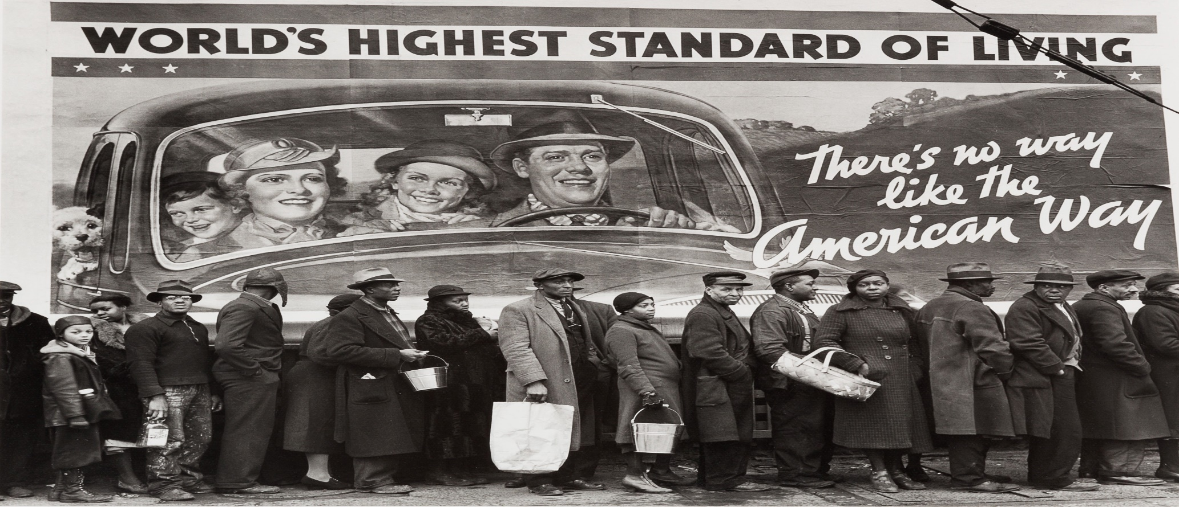
Hypothesized Causes of the Great Recession
Low-interest rate
High public debt
Notes:
The great recession began in the United States which was later felt by other countries. Although the recession lasted for a longer period, many people faced significant challenges including a reduction in salaries and loss of houses. The labor market was also not left unaffected because the unemployment rate increased from 4 percent to more than 9 percent. Low-interest rate led to people borrowing loans which yielding to increased public debt. More loans provided fueled increased money supply and thus people purchased houses, nevertheless, as more people had the money the demand for houses surpassed the supply. When the fed increased taxes, people who had loans were unable to pay and the amount for selling houses also reduced as demand decreased.

Slide 8
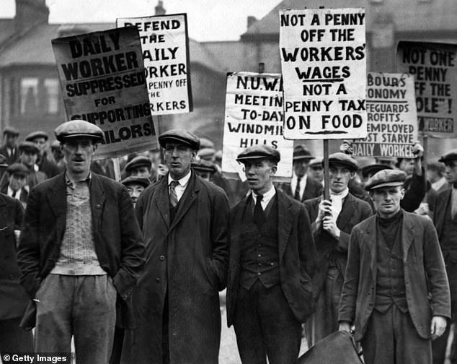
Fiscal and Monetary Policies in the Great Recession
Tax cut (Holland et al., 2018)
Increase government spending
Keep interest rates low
Reduce unemployment
Notes:
Fiscal and monetary policies are essential in reducing recession as well as in the recovery process. Fiscal policies used in the great recession period includes tax cuts and government spending (Holland et al., 2018). During the recession, the government needs to cut tax to ensure individuals can access the required needs. Similarly, government spending needs to be increased during the recession as money will be required in other important projects to sustain individuals and businesses. Monetary policies used are keeping interest rates down and decreasing unemployment. Before the recession interest rates were low thus, the federal reserve had to take actions of increasing interest rates which affected individuals in debt. Also, after the recession, they had to increase the employment rate to help the country recover.

Slide 9
Changes in the US Economy From the Great Recession
The unemployment rate increased to ten percent (Tooze, 2018)
The United States Gross Domestic Product (GDP) decreased by 0.3 percent in 2008 and 2.8% in 2009 (Tooze, 2018)
The United States housing market moved from boom to bust
There is a possibility for a future recession because of high inequality
Notes:
The great recession eventuated in significant changes in the United States. Hence, with the increase in a recession, many businesses and companies were faced with a reduction in sales, thus resulting in increased unemployment of up to 10% (Tooze, 2018). While the country has been working to improve the number of people who are employed recession led to a decline. Also, the United States GDP decreased by 0.3% in 2008 and 2.8% in 2009 as sales were few and business did not operate as usual (Tooze, 2019). Similarly, the housing market reduced abruptly due to a fall in demand. The future recession might happen but not with the same magnitude as that of the great depression because of the increased inequality.

Slide 10
Conclusion
The great recession was expensive to Americans as it led to the loss of income and employment
Fiscal and monetary policy can manage a recession
Economic policy to avoid a future recession by targeting higher inflation
Secondly, guaranteeing financial stability
Thirdly, devaluation to enhance aggregate demand
Notes:
In summation, the great recession eventuated to increased challenges to Americans. For instance, the recession is costly because it results in the loss of jobs and income. However, when fiscal and monetary policies are used well recession can be managed. Fiscal and monetary policies such as maintain interest rates low and cutting taxes are essential. I would propose several economic policies to avoid future recessions, the first one is high inflation targeting as it will aim at development as low inflation leads to slow growth. Secondly, guaranteeing financial stability for individuals to have confidence in the banking system to avoid bank closures and reduction in the money supply. Finally, through devaluation aggregate demand is enhanced.

Slide 11
References
Bivens, J. (2019). What should we know about the next recession? Economic Policy Institute. https://www.epi.org/publication/next-recession-bivens/
Committee for Economic Development. (2018, April 4). What is the ‘national debt’ and why does it matter? https://www.ced.org/reports/what-is-the-national-debt-and-why-does-it-matter
Frick, W. (2019). How to survive recession and thrive afterward. Harvard Business Review. https://hbr.org/2019/05/how-to-survive-a-recession-and-thrive-afterward
Homburg, S. (2015). What Caused the Great Recession?. Review of Economics, 66(1), 1-12. https://doi.org/10.1515/roe-2015-0102
Holland, J., Leamer, E., & Rivlin, A. (2018, July). Perspectives on U.S. fiscal policy. Business Economics 53(3), 124–133. https://doi.org/10.1057/s11369-018-0083-3

Slide 12
References Cont.
Ponnuru, R. (2018, September 10). Rethinking the recession: Blame the Fed’s monetary policy. National Review, 70, 26–28. https://www.nationalreview.com/
Tooze, A. (2018, September). The forgotten history of the financial crisis: What the world should have learned in 2008. Foreign Affairs, 97, 199–210. https://www.foreignaffairs.com/

